Slide 1

Updates
Michelle Nienhius, MPH
Manager, Division of Prevention and Intervention Services
November 3, 2022
Notes:
Custom DAODAS color codes is : Red-0
Green-131
Blue-139

Slide 2
Topics Addressed:
FY23 Funding and Compliance Contract and Prevention Services Manual
AET Updates
STEP/TEP/PREP
Synar Study Updates
SOR Updates
Naloxone Saturation Plan
JPK and One Fake Pill Can Kill Campaign Updates
Training/Resources

Slide 3
FY 23 Funding and Compliance Contract and Prevention Services Manual
Executive Director should provide a copy of the contract to the Prevention Director
Prevention Services Manual has been updated for FY23 and the revised copy will be placed on the SC Documents website (https://ncweb.pire.org/)
Reminders:
All full- and part-time employees delivering prevention services shall have a period of 36 months from their permanent date of hire to obtain prevention certification through the South Carolina Association of Prevention Professionals and Advocates. The certification timeline allows agencies to include a probationary period, not to exceed six months, if they desire.
All prevention professionals must have a training plan for obtaining and maintaining certification. This plan must be updated annually.
All prevention staff shall attend the Substance Abuse Prevention Specialist Training (SAPST) within two years of their hire date.

Slide 4
A key element for ensuring that the highest-quality prevention services are provided to all South Carolina citizens, organizations funded by DAODAS through the Substance Abuse Prevention and Treatment Block Grant (SABG) shall obtain and maintain national accreditation by either the Joint Commission or CARF International for their primary prevention programs that target children, youth/adolescents, and adults.
Each agency shall have at least one representative attend the Prevention Quarterly Meetings that are held by DAODAS on the first Thursday (unless notified of a change by DAODAS) of the following months: August, November, February, and May.
All prevention personnel funded through the SABG Primary Prevention Set-aside (regardless of percentage of salary funded) are required to enter direct and indirect service hours into the web-based reporting system each month. The percentage of staff time entered is expected to be direct/indirect service time in order to accomplish each agency’s goals/objectives that have been set for primary prevention. Each agency is required to complete the Prevention Staffing Capacity Plan and send to DAODAS by the end of July each year. It is the responsibility of the agency to send to DAODAS a revised Prevention Staffing Capacity Plan if there are any personnel changes, staff funding changes, etc., that occur throughout the fiscal year.

Slide 5
Each prevention staff member funded under the SABG Primary Prevention Set-aside shall enter data by the end of each week. However, minimal standards for timeliness are that all data must be entered monthly, with reporting complete by the eighth working day of the following month. If there is a need for an extension for data entry, a request shall be made by the agency to the DAODAS Manager of Prevention and Intervention Services at least five business days in advance of the deadline.
Minimum standards for accuracy of monthly data entered into the web-based reporting system are as follows:
a) correct application of service categories (direct vs. indirect) and populations served;
b) required monthly documentation of service hours for any organizational member or volunteer who is providing prevention services;
c) Demographics of people served in prevention services as required for federal reporting;
d) appropriate documentation of funding and reporting to ensure compliance.

Slide 6
Prevention providers are required to use the DAODAS Standard Survey (provided separately) as an evaluation tool for any multi-session education program aimed at youth ages 10 to 20. This applies to research-based and non-research-based programs. Program exceptions for the use of the DAODAS Standard Survey are noted and defined in the South Carolina Prevention Evaluation Handbook. There is a paper and online version of the survey available.
**These are just a few highlights from the Manual, please read the entire document and contact DAODAS with any questions.

Slide 7
AET Updates
Social media calendar was sent out for fall football/tailgate season
Working on updating holiday/winter social media calendar for December
AET Coordinator’s Meeting scheduled for November 8th at LRADAC Education Center
  AET 101 TOT
  GMS
  West Columbia Police Department presentation (updates on recent environmental scans)
  AET Circuit Sharing
AET Training- November 9
  AET 101 8:30 am- 12:30 pm
  Fake and Fraudulent IDs 1:30-5:00 pm
  Lynches River County Park, 5094 County Park Road, Cowards, SC 29530
  http://www.scoutoftheirhands.org/training-events--registration.html
  Next meeting will be held January, 2023

Slide 8
SYNAR and STEP Program Overview
Synar Tobacco Enforcement Partnerships (STEP)
The SC STEP program is an incentives based program that incorporates current aspects of our state’s prevention system, the Synar study, merchant education, and mandated county tobacco compliance checks, with federal mandates and other tobacco control and enforcement initiatives, the Synar coverage study (federal requirement) and tobacco strategy incentives. (i.e., Tobacco Education Program, Point-of-Sale work, and Multi-Jurisdictional Law Enforcement Agreements).
The intent is for the STEP program to package tobacco enforcement best practices and requirements and provide financial incentives to encourage the use of best practices at the local level.
Each year, a portion of the Substance Abuse Block Grant (after the costs are reimbursed for the Synar study and bonuses) is divvied up and allocated based on the STEP-approved activities completed in each county.

Slide 9
SYNAR and STEP Program Overview
Counties can earn STEP points for some or all of the following efforts:
• Conducting tobacco compliance checks,
• Reporting new tobacco outlets and cleaning their list frame,
• Merchant Education,
• Tobacco Education Program,
• Point-of-Sale Taskforce development,
• Merchant Pledge(s),
• Establishing multi-jurisdictional law enforcement agreements around tobacco.
Please use the following designated STEP email address to ask DAODAS questions regarding STEP: daodas.stepprogram@daodas.sc.gov
Additionally, all templates, forms, and the new STEP Cover Sheet are on the SC Documents webpage: Search STEP

Slide 10
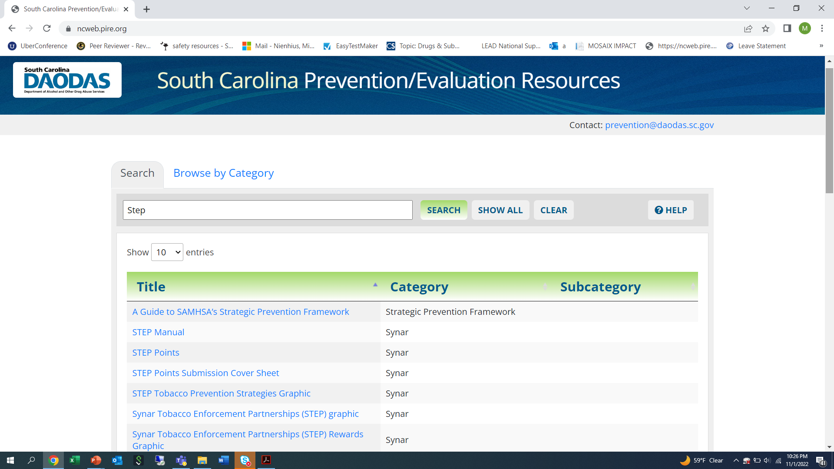

Slide 11
PREP Reminders
Revisions have been made to the PREP curriculum
All materials are on DAODAS website: https://www.daodas.sc.gov/services/prevention/merchant-initiatives/
PREP Training Materials- this is a password protected site
Password will be provided via email once staff members complete TOT
TOT training on Relias: The video can be found under the following title and individuals can self-enroll South Carolina Palmetto Retailers Education Program Training of Trainers 2022 (PREP TOT)
Please use the new fillable forms-all names and addresses should be typed into the new forms-handwriting is difficult to read and postage is being wasted when cards are returned to the agency.

Slide 12
Tobacco Education Program (TEP)
Statewide committee continues to meet to update the curriculum
Utilizing the Stanford ToolKit to update the curriculum
There is a training coming up for program implementation hosted by Stanford Toolkit November 10th – TEP Committee members will be participating in the virtual training
New fidelity checklist and other materials will be developed by the committee following the training
Goal is to have curriculum updated before end of calendar year

Slide 13
SYNAR Study Updates
Study Changes approved by SAMSHA as of October, 2022:
In order for SC to be in compliance with the Tobacco 21 Federal law, the ages for the Synar study volunteers have been modified. New requirement: SC will use 16,17,18,19 and 20- year-olds to conduct the study
While the age of the volunteers will be increased for the Synar study, South Carolina will only be able to use youth ages 16-17 for enforcement of state law by local law enforcement as the State law for South Carolina remains 18. State law does not supersede Federal law as it relates to businesses and merchants.
The Palmetto Retailers Education Program (PREP) teaches merchants that they must follow the Federal Tobacco 21 Law and not sell tobacco to anyone under 21. They are also taught how to properly check an ID and not sell tobacco products to anyone under 21.
Volunteers will carry identification and provide to clerk (if asked)
Youth will attempt to purchase cigarettes of electronic cigarette (ENDs)
Youth inspectors can survey no more than 5 outlets

Slide 14
SYNAR Study Updates
Youth receive training from the county coordinators prior to the inspections. Youth must be age 16-20.
There are no specific time-of-day requirements, but all surveys must be completed during the federal fiscal year.
Youth volunteers under the age of 18 must have their parents or guardian’s complete permission forms prior to participation.
Youth inspectors between the ages of 18-20 must complete a participation agreement form.
All inspectors ages 16-20 must sign a participation form in order to volunteer as an inspector for the study.

Slide 15
SYNAR Study Updates
The study timeframe will take place between December 1, 2022 –February 10, 2023 or March 1, 2023 – May 12, 2023. This is dependent upon which group you are in.
  Region 2 and 3 are December 1, 2022 – February 10, 2023. If you are requesting an extension due to COVID, you must submit request in writing to DAODAS (prevention@daodas.sc.gov) by January 21, 2023. Paperwork must be mailed (postmarked) to DAODAS by February 20, 2023.
  Region 1 and 4 are March 1, 2023– May 12,2023. If you are requesting an extension due to COVID, you must submit request in writing to DAODAS (prevention@daodas.sc.gov) by April 28, 2023. Paperwork must be mailed (postmarked) to DAODAS by June 2, 2023.
Regions 2 and 3 will need to complete the Annual Synar Study training on Relias between November 25-December 9, 2022.
Regions 1 and 4 will need to complete the Annual Synar Study training on Relias between January 17th and February 24, 2023. More information to come
Synar Manual will be updated and placed on SC Documents website: https://ncweb.pire.org/scdocuments/ by November 25, 2022

Slide 16
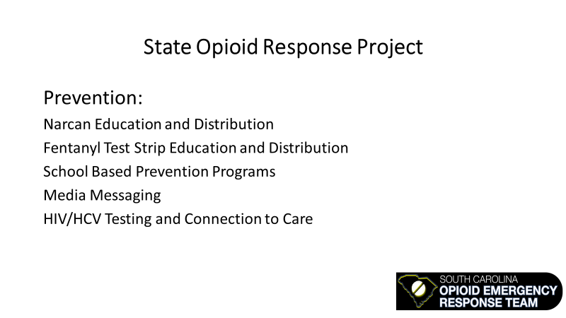

Slide 17
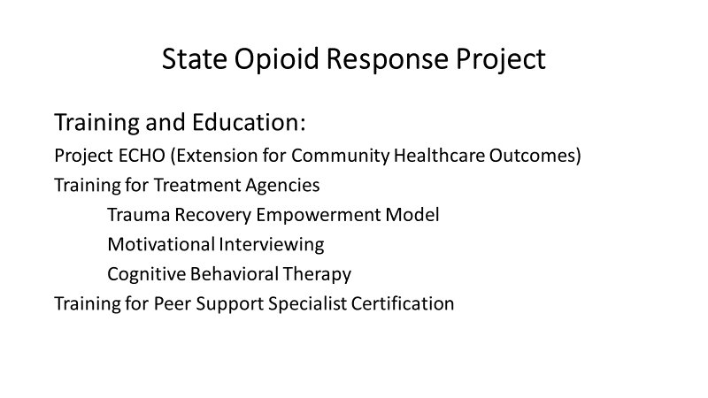

Slide 18
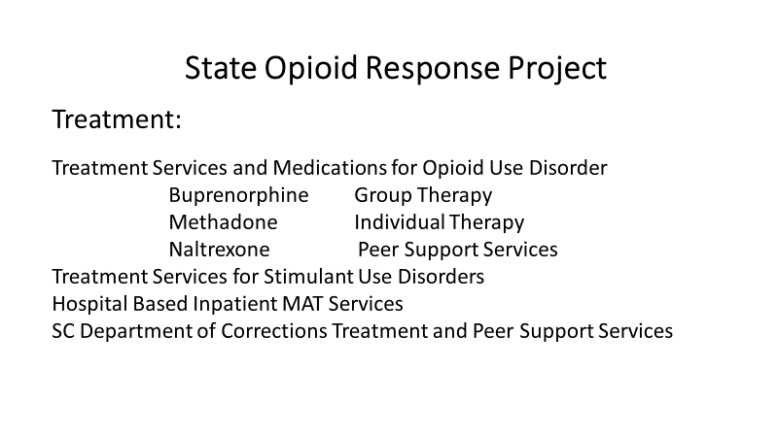

Slide 19
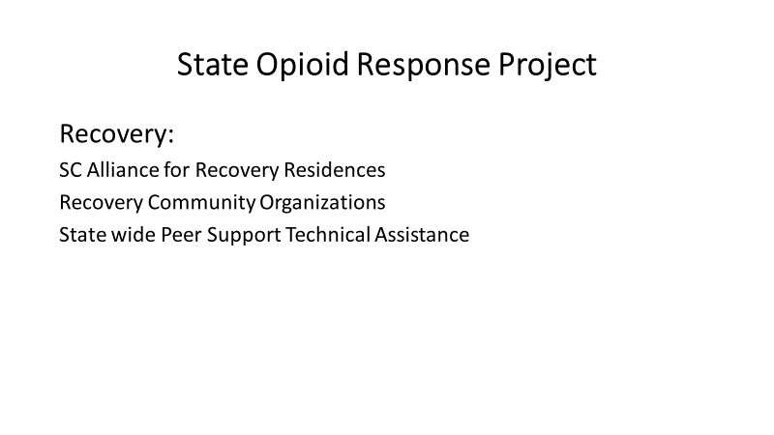

Slide 20
Naloxone saturation plan-Requirement of new SOR Grant
Saturation calculated using the protocol from the Maryland state:
  Formula: Target saturation = Deaths attributed to opioid overdose in target area *20
  Areas defined in terms of SC counties
  CY2020 the total number of overdose deaths related to opioids= 1,400
  Total target distribution for SC = 28,000 naloxone kits (1,400 X 20)

Slide 21
County | Total Number of Overdose Deaths in 2020 | Naloxone Saturation (Total # deaths x 20)
Abbeville | 2 | 40
Aiken | 57 | 1140
Allendale | 0 | 0
Anderson | 47 | 940
Bamberg | 4 | 80
Barnwell | 1 | 20
Beaufort | 30 | 600
Berkeley | 41 | 820
Calhoun | 1 | 20
Charleston | 168 | 3360
Cherokee | 4 | 80
Chester | 7 | 140
Chesterfield | 7 | 140
Clarendon | 1 | 20
Colleton | 4 | 80
Darlington | 6 | 120
Dillon | 16 | 320
Dorchester | 34 | 680
Edgefield | 4 | 80
Fairfield | 8 | 160
Florence | 44 | 880
Georgetown | 26 | 520
Greenville | 144 | 2880

Slide 22
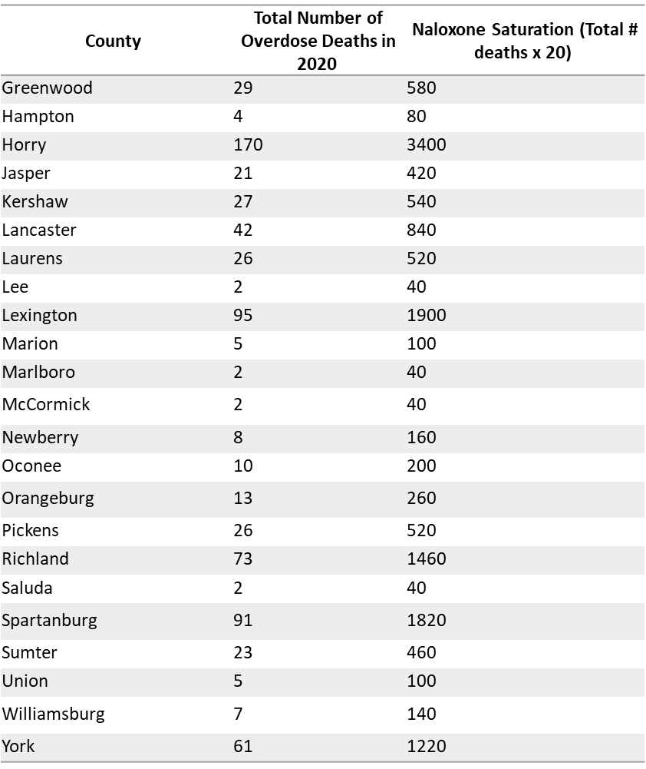

Slide 23
Progress on Meeting Naloxone Saturation Plan
Data from distribution for previous federal fiscal year (October 2021 –September 2022) broken down by county, indicated:
18 South Carolina counties exceeded saturation level by 10% or more
2 South Carolina counties met or exceeded saturation level by less than 10%
3 counties were approaching the saturation rate with their distribution (within 10% of goal)
The remaining 23 counties did not meet the saturation plan level and will need to increase naloxone distribution levels in order to reach saturation levels in the upcoming years
Targeted distribution and communication strategies to get naloxone into the hands of those most likely to witness an overdose need to be increased

Slide 24
Next Steps:
We need to work with the current CDs and other groups to recruit additional partners to become CDs to increase access to naloxone throughout each county.
We also need to work with the CDs to utilize the Overdose Detection Mapping Application Program (ODMAP) to identify “hot spots” in the county where overdoses occur.
CDs should set up distribution events and targeted outreach in areas (parking lots, hotels, churches, shelters, etc.) near the identified hot spots to target dissemination to individuals at high risk of witnessing an overdose.
CDs will continue to promote the anonymous survey designed to collect naloxone administration data from laypeople

Slide 25


Fake Pills Campaign Recap

Slide 26
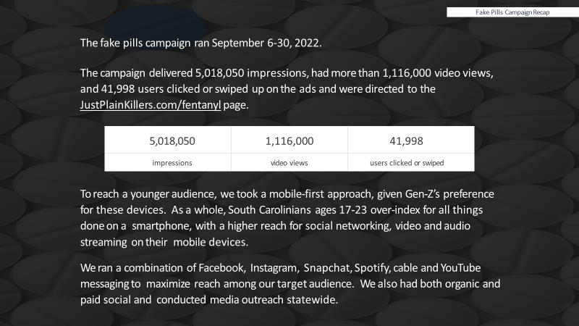

Slide 27


Slide 28
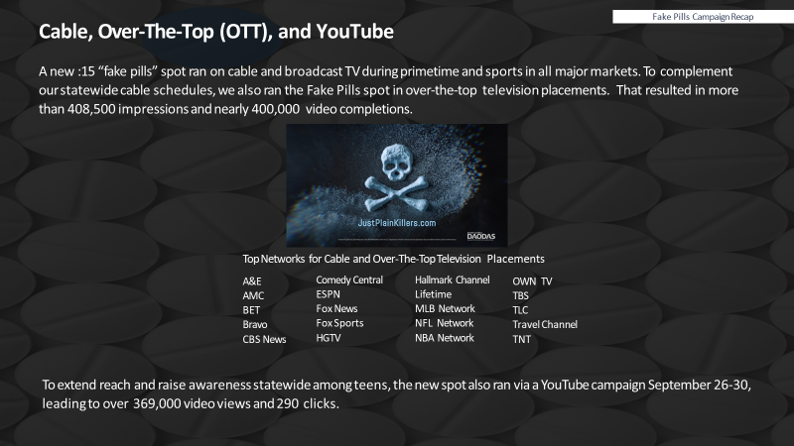

Slide 29

Fake Pills Campaign Recap

Slide 30
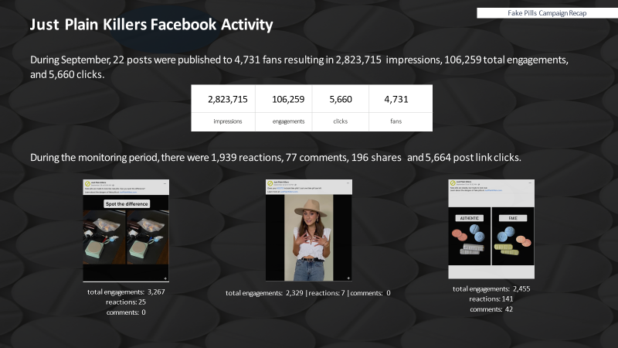

Slide 31
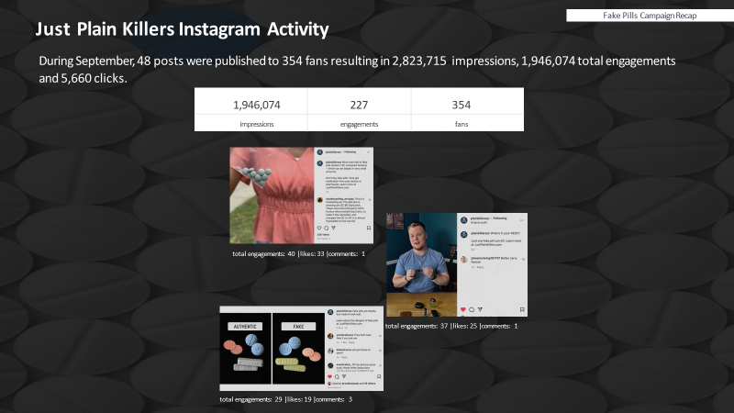

Slide 32
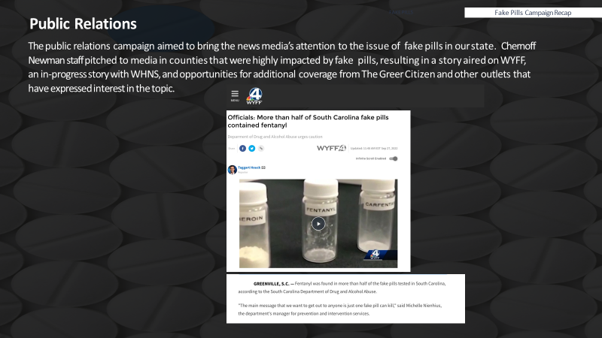

Slide 33
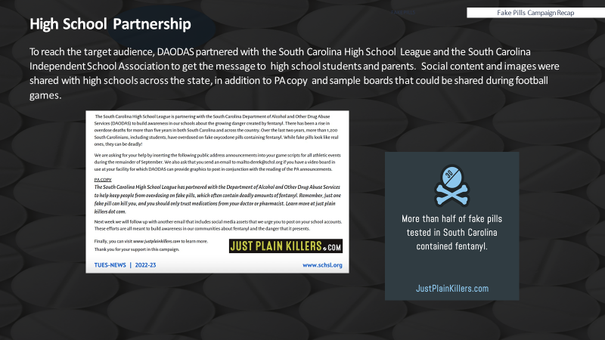

Slide 34
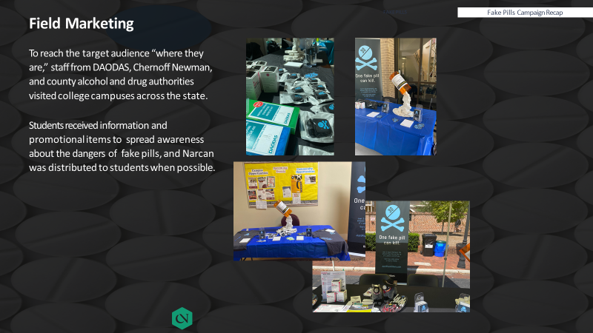

Slide 35


Slide 36
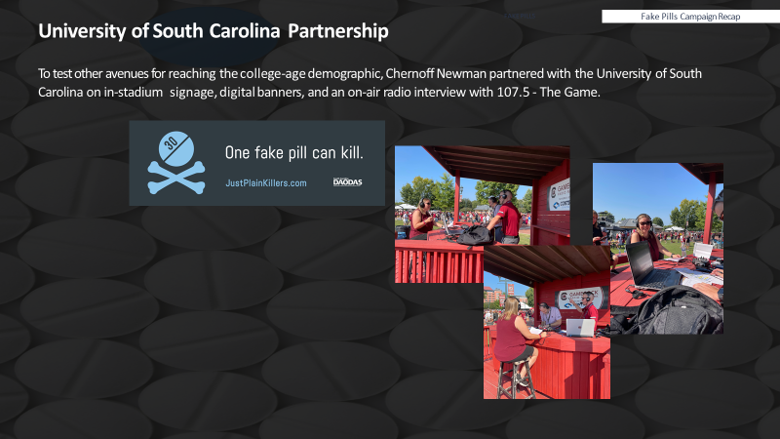

Slide 37
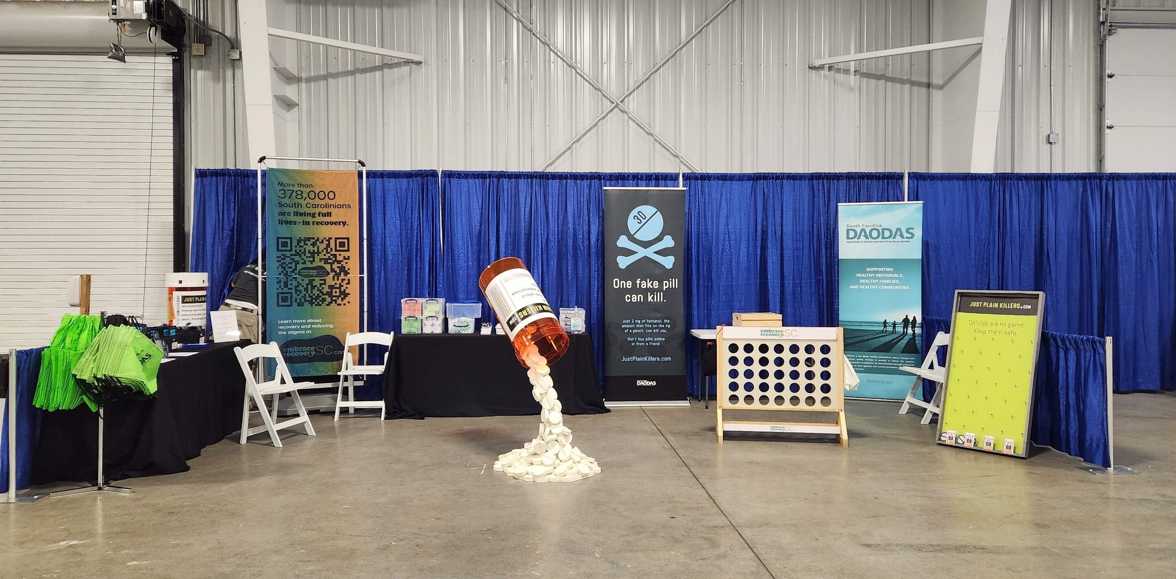

Slide 38



Slide 39
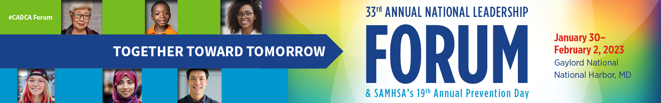
When is CADCA's National Leadership Forum?
Forum occurs Monday, January 30 - Thursday, February 2, 2023
Where is Forum being held?
Forum will take place at Gaylord National in National Harbor, MD.
Who attends Forum?
Educators | Faith Leaders | Individuals in Recovery | Justice Personnel | Law Enforcement | Mental Health Consumers | Military and Military Families | Parents | Prevention Specialists | Public Health Professionals | Researchers | State and Local Coalition Leaders | Substance Use & Mental Health Professionals | Treatment Providers | Youth
Forum Offers:
Training from top experts in the field
Information, tools and strategies to take your prevention work to the next level
The latest science, news and trends on substance misuse issues
The opportunity to network with thousands of advocates passionate about prevention
Specialized youth leadership training
https://www.cadca.org/forum2023/registration

Slide 40

Lifesavers is recognized as the premiere conference to learn about the latest highway safety research, best practices, and cutting-edge initiatives; and to explore innovative technology and strategies used to combat risky driving behaviors and save lives. The Lifesavers Conference is also historically the world’s largest gathering of leaders and advocates in traffic safety. Now in its 41st year, the Lifesavers Conference will take place April 2-4, 2023 in Seattle, WA
The 2023 Lifesavers Conference will provide a national platform with over 70 workshops in nine tracks, plenary sessions, peer exchange discussion groups, and an extensive exhibit hall. The Lifesavers Conference program is designed to engage federal, state and local government, law enforcement, public health, injury prevention, advocacy, and non-profit organization professionals in an exchange of ideas, strategies, and programs to reduce preventable injuries and deaths.
https://lifesaversconference.org/registration/

Slide 41

April 10-13, 2023
More than one million lives have been lost since the start of the opioid epidemic. Overdose deaths have reached record rates, and we can't afford for more lives to be lost. It's time to turn the numbers around. Rx Summit is the largest, most influential event addressing this crisis, where strategies are shared and put into action. Our global community is made up of multidisciplinary stakeholders "from federal to family". Join us next year in Atlanta to learn the latest strategies for prevention, treatment, and recovery.
Located in the heart of downtown Atlanta, Georgia World Congress Center (GWCC) features 1.5 million square feet of prime exhibit space and is the world’s largest LEED certified convention center.
https://www.rx-summit.com/rates
https://www.rx-summit.com/rates

Slide 42


2023 NLLEA Annual Conference
October 9-11, 2023
Call for Workshop Proposals
Proposal Submission Guidelines
Deadline January 31, 2023
https://www.nllea.org/home

Slide 43
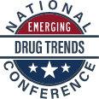
NOVEMBER 8TH & NOVEMBER 9TH, 2023
Historic Charleston, South Carolina
The 2nd Annual National Emerging Drug Trends Conference will be held on November 8th and 9th, 2023 in historic Charleston, South Carolina. The conference is an exclusive drug education and enforcement conference highlighting an array of superior speakers with expert knowledge.
REGISTRATION
Early Registration: Will open in January of 2023!
https://www.emergingdrugtrends.com/about
SAVE
T H E
DATE

Slide 44

1801 Main Street, 4th Floor • Columbia, South Carolina 29201
telephone: 803-896-5555 • fax: 803-896-5558
www.daodas.sc.gov
Notes:
Final Slide

